Slide 1
General Education Implementation Committee
September 23, 2024

Slide 2
General Education Vision Committee
Holly Anthony (co-chair), Curriculum & Instruction
Allan Mills (co-chair), College of Arts & Sciences
Steven Anton, Mechanical Engineering
Jeremy Blair; Art, Craft, & Design
Kent Dollar, History
Helen Hunt, English
Samantha Hutson, Human Ecology
Jeanette Luna, Earth Sciences
Linda Null, English & Chair of the General Education Committee
Richard Pirkle, Biology
Lenly Weathers, Civil & Environmental Engineering
Heather Bertram, College of Education (student)

Slide 3
Gen Ed Vision Committee Goals & Recommendations
The goals of this committee were to:
To develop a vision/philosophy for general education at TN Tech,
Identify potential pathways for operationalizing that vision, and
See what might be possible as we “dream big.”
Recommendations were compiled from data gathered from students, faculty, staff, and administration via 27 Town Hall Open Forums and a Qualtrics Survey (1200+ respondents).

Slide 4
Suggested Vision:
Tech is Tomorrow. Through our general education curriculum, Tennessee Tech provides a pathway to tomorrow’s opportunities. We envision a future where our students, empowered by a foundation of critical thinking, cultural awareness, and creativity are prepared to navigate and shape the challenges and innovations of tomorrow. Tennessee Tech’s general education program is the cornerstone of a future where our graduates lead with confidence, adaptability, and a commitment to lifelong learning.
Rationale: Points toward future but allows all colleges to participate.

Slide 5
Recommendation 1
Rename the current categories/buckets for General Education courses such that no name is the same as a department/unit on campus.
Rationale: Categories whose names mirror those of departments(e.g., Mathematics, History, Communication) may convey a message that only those departments can offer courses within that category/bucket. More inclusive category/bucket names should make it clearer that any department can propose courses within a bucket (provided that the proposed course is aligned to the Student Learning Outcomes (SLOs) aligned with that category/bucket).

Slide 6
Recommendation 2
Provide more choices in the various General Education categories/buckets.
Rationale: Some of the current categories/buckets(e.g., Communication; History; the Humanities/Fine Arts literature requirement, etc.) require students to choose from among only two or three courses. Providing more choices within these categories/buckets would allow students more flexibility in schedules and more “ownership” in how they fulfill the general education requirements. It would also allow departments more flexibility in scheduling and allocation of faculty/resources since more “boutique”/specialized courses could be offered (for example, History of American Innovation could be appealing to STEM majors and count for general education credit).

Slide 7
Recommendation 3
Investigate the possibility of a course meeting the requirements of multiple General Education categories/buckets (provided the alignment with the appropriate SLOs are documented/evidenced).
Rationale: Faculty could collaborate to co-teach a course that could count within two general education categories/buckets.

Slide 8
Recommendation 4
Create a mechanism such that “one-off” courses can be offered for general education credit, like the mechanism used currently for Honors courses. Could a course be proposed and offered in only one semester but count for general education credit?
Rationale: Faculty could offer more innovative and immediately relevant general education courses but not be committed to a permanent addition to their course load. Faculty from departments not traditionally associated with general education course offerings would have more opportunities to participate.

Slide 9
Recommendation 5
Investigate how faculty/departments/colleges can share/distribute SCH/load when faculty from different units collaborate to create/deliver general education course.
Rationale: Faculty could collaborate to co-teach courses and equitably share/distribute the SCH/load.

Slide 10
Recommendation 6
Consider ways to incorporate Career Exploration, Financial Literacy, ideas of Global Citizenship, and Digital/Technological Literacy (Artificial Intelligence) into general education. Some options might be “embedded strands/threads” within/across general education categories/buckets and/or new categories/buckets that allow for the inclusion of these ideas. Micro-credentials or certificates/badges could be considered here.
Rationale: Students have asked for these in general education and many institutions incorporate these concepts in their general education offerings.

Slide 11
Additional Recommendation 1
Move the General Education website to a more visible location (perhaps Academic Affairs) rather than housed within the College of Arts & Sciences (CAS).
Rationale: General education courses are offered by various schools/colleges across campus and the general education requirements should stand out in the catalog and on the University website.

Slide 12
Additional Recommendation 2
Move the university faculty teaching award for general education to Academic Affairs where all other faculty excellence awards are housed.
Rationale: General education courses are taught by faculty in various schools/colleges across campus.

Slide 13
Additional Recommendation 3
Make the General Education Committee (that reviews course proposals, transfer credits, etc.) a university standing committee that reports to Academic Affairs with a regular rotation of faculty representatives (like all other university standing committees). A new policy would be needed to address issues such as appeal processes if a proposed course is denied, terms of service for committee members, etc.
Rationale: The General Education Committee is currently a subcommittee of the University Curriculum Committee. Elevation to a standing University Committee would emphasize the importance of general education to the University mission.

Slide 14

General Education Implementation Committee (n=31) *co-chairs: Linda Null Holly Anthony
Implementation Committee
General Education Committee
Tony Baker, English
Allan Mills, Mathematics
Arthur Banton, History
Kim Winkle; Art, Craft, & Design
Lori Maxwell, Sociology & Political Science
Daniel Combs, Biology
Melinda Anderson, Human Ecology
Scott Christen, Communication
Julie Galloway, College of Business SSC
Steve Isbell; Econ, Finance & Marketing
Barbara Jared, Nursing
Krystal Kennedy, Curriculum & Instruction
Jeannie Smith, Interdisciplinary Studies SSC
Jerri Winningham, Enrollment Management
Lenly Weathers, Civil & Environmental Engineering
Holly Anthony,* Curriculum & Instruction
Linda Null,* English
Deborah Barnard, Foreign Languages
Stacey Browning, Nursing
Janet Coonce, Chemistry
Brittany Copley, Registrar
Chuck Craig, CoEd SSC
Dennis Fennewald, Agriculture
Colin Hill, Music
Kelly McCallister, Volpe Library
Collen Mestayer, Communication
Alma Núñez; Econ, Finance, & Marketing
Lindsey Roberts, Honors
Cara Sisk, Human Ecology
Doug Talbert, Computer Science
Chris Wilson, General & Industrial Engineering
Notes:
All Colleges have representation except Army ROTC.
College of Agriculture & Human Ecology (3)
College of Arts & Sciences (8)
College of Business (3)
College of Education (3)
College of Engineering (3)
College of Fine Arts (2)
College of Interdisciplinary Studies (3)
Whitson-Hester School of Nursing (2)
Honors Program (1)
Volpe Library (1)
Addtionally, we have:
Registrar (1)
Enrollment Management (1)

Slide 15
Gen Ed Implementation Committee Charge
The goals of this committee are to:
Review the Gen Ed Vision Committee’s recommendations, and
Involve campus stakeholders to develop a detailed implementation plan for those recommendations.
Seven (7) subcommittees have been formed to accomplish this work.

Slide 16
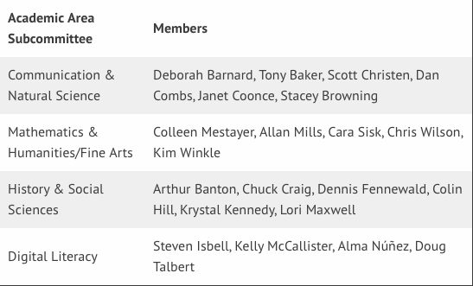
Academic Area Subcommittees (4) Lead co-chair: Holly Anthony
**Academic Areas SC members are encouraged to contribute to Procedural SCs.

Slide 17
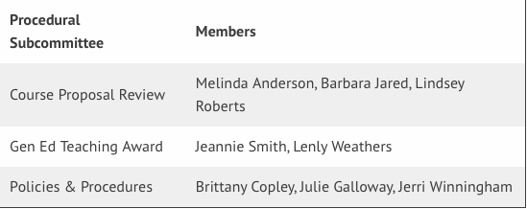
Procedural Subcommittees (3) Lead co-chair: Linda Null
**Procedural SC members are encouraged to contribute to Academic Areas SCs.

Slide 18
SC1–4: Academic Area Subcommittees
SC1: Communication & Natural Sciences SC2: Mathematics & Humanities/ Fine Arts
SC3: History & Social Sciences SC4: Digital Literacy
Charge:
Review SLOs in current Gen Ed Categories/Buckets and revise/update to ensure the Gen Ed Vision is captured
Where do Digital Literacy and Financial Literacy belong (if anywhere)? New categories/buckets and/or embedded strands?
Organize SLOs into appropriate categories/buckets proposing new category/bucket names (as needed) and/or new buckets/categories
Review credit-hour requirements (total credits and credits/category)

Slide 19
SC5: Course Proposal Form
Charge:
Consider revisions in the current procedure for submitting a course to be included in the General Education curriculum
Develop a new form for proposing a General Education course.
Develop a procedure for submitting a TTU course to count as a General Education course but not to be included permanently as a General Education option (similar to a Special Topics course). (not to be confused with course substitutions for transfer students)
Develop a procedure for appealing a rejection of a course submitted as a General Education course but not accepted (consult with Policies/Procedures Subcommittee)

Slide 20
SC6: General Education Teaching Award
The General Education Teaching Award Committee is currently a subcommittee of the General Education Committee. It is migrating to a university-wide committee akin to other university awards within Academic Affairs. As such, policies and procedures must be reviewed and updated.
Charge:
Revision of current procedure for selecting nominees
Revision of the documents sent to nominees

Slide 21
SC7: Policies and Procedures
The General Education Committee is currently “housed” within Arts and Sciences. It will become a Standing University Committee. As such, the policies and procedures must be reviewed and updated.
Charge:
Revision and further development of General Education Committee Procedures
You should especially but not exclusively consider how to rotate members of the committee to allow for some continuity over time.
You should develop policy/procedures around appealing a course approval decision (consult with Course Proposal Subcommittee)
Make recommendations for revision of Policy 259 General Education for subsequent committee

Slide 22
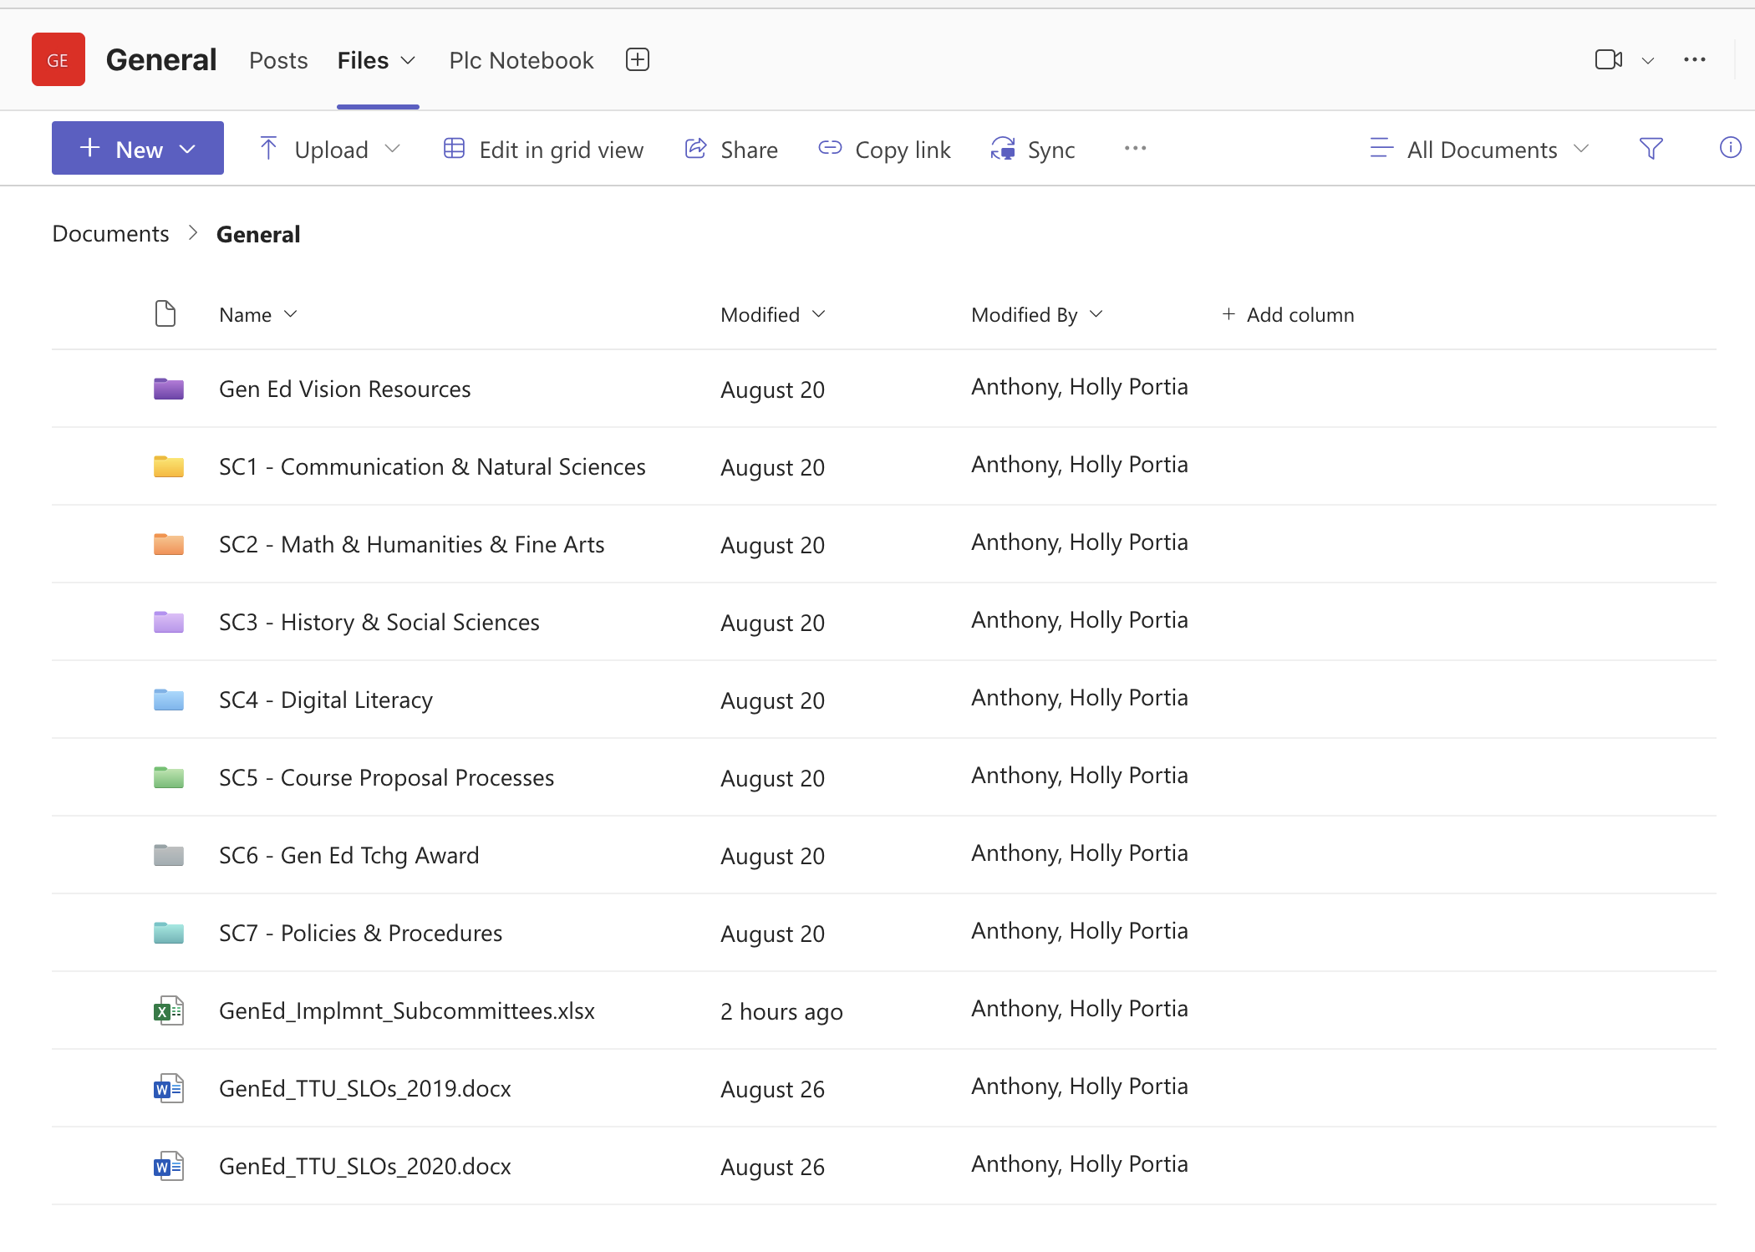
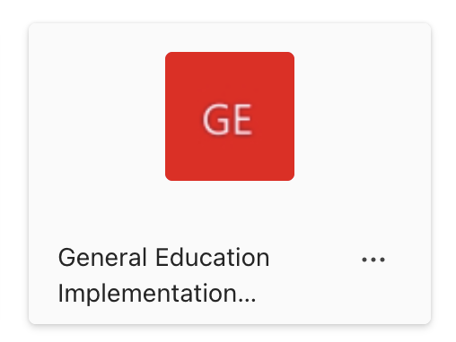
TEAMS

Slide 23
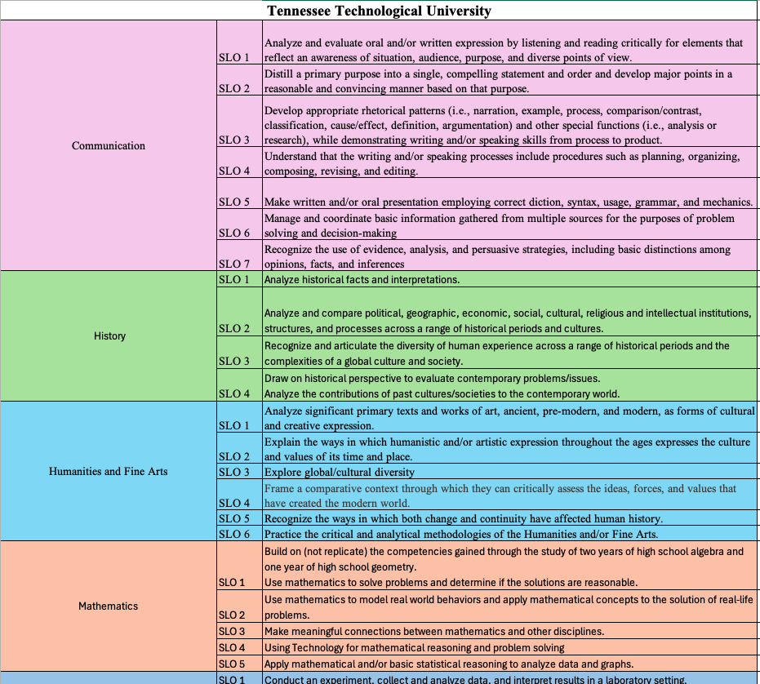
SLO spreadsheet
This spreadsheet contains 27 universities’ General Education SLO’s
General Education SLO’s

Slide 24
What to consider?
**We should pay attention to SACSCOC guidelines, our vision for general education, and what is best for our students.
The following will come later. For now, these should not guide our work/recommendations.
Plans for course substitutions and transfer pathways
Transcript designations of general education courses
Department/faculty ownership of courses/load
TBR/legislation exceptions/requests (if needed)
Final Revision of Policy 259 General Education
Notes:
Re: course substitutions: (consider category-to-category substitutions rather than course-to-course substitutions)
TBR/legislation exceptions/requests may be needed if, for example, we decide to reduce our required credit hours and/or lift the requirement for American History.

Slide 25
Timeline
Meeting to be held Week of November 18 for subcommittee reports and progress
Share proposals/ideas with Faculty Senate (January 27, 2025)
Work completed to hand-off to next committee (March 2025)
Today:
Work with Subcommittee Members to set a meeting schedule to accomplish work (post in Teams SC folder) – stay connected with assigned lead co-chair (Linda or Holly)
Review charge and ask questions to clarify tasks (set interim milestones)

